Slide 1
Northwind Sales Data Analysis (SQL)
-Pavan Kumar. C
4th Sem BCA – ‘B’
BDA238957 / U03ZJ23S0087
Data Analytics Specialization

Slide 2
What is this project about?
It details and showcases our querying procedures and methods used to retrieve necessary data from a sample company database - Northwind, utilizing SQL queries and methods.
The following slides showcase 10 of the relevant questions and queries used and results pertaining to sales analysis of given database.

Slide 3
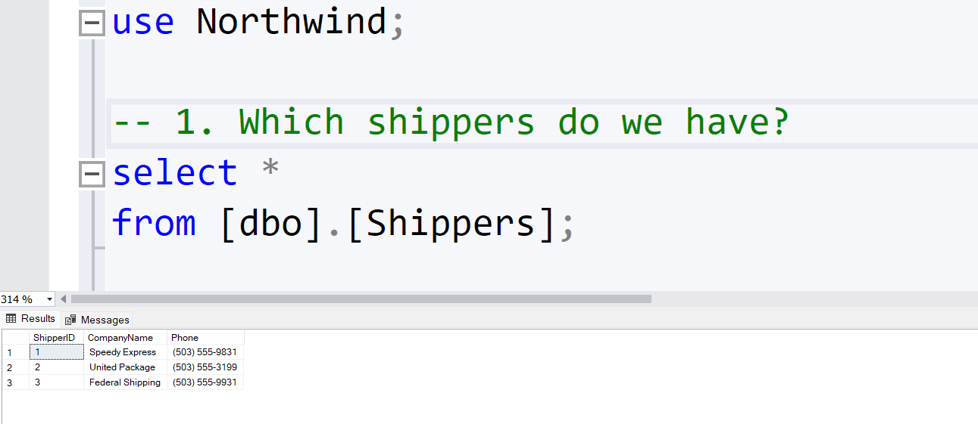
1. Which shippers do we have We have a table called Shippers. Return all the fields from all the shippers

Slide 4
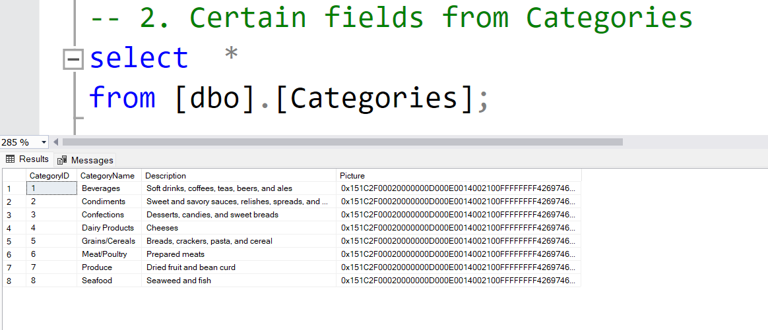
2. Certain fields from Categories In the Categories table, selecting necessary fields and display results.

Slide 5
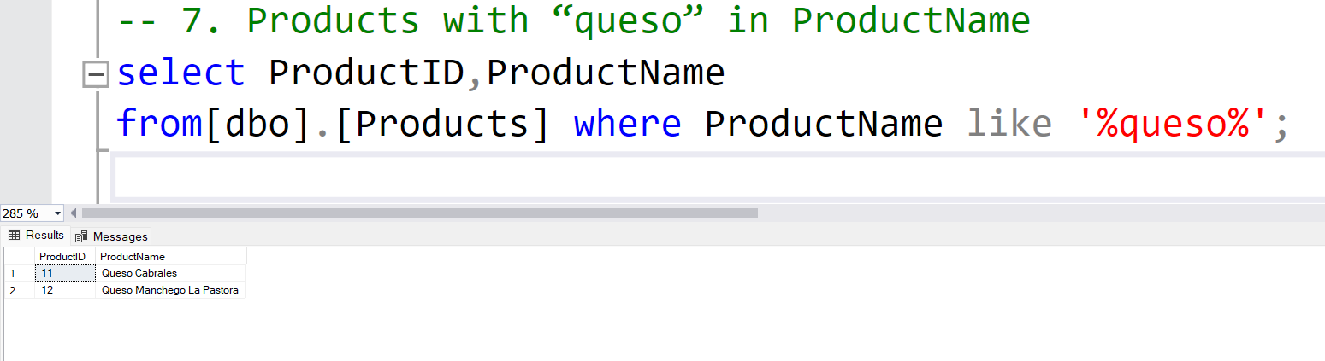
3. Products with “queso” in ProductName In the products table, display the details for those products where the ProductName includes the string “queso”.

Slide 6
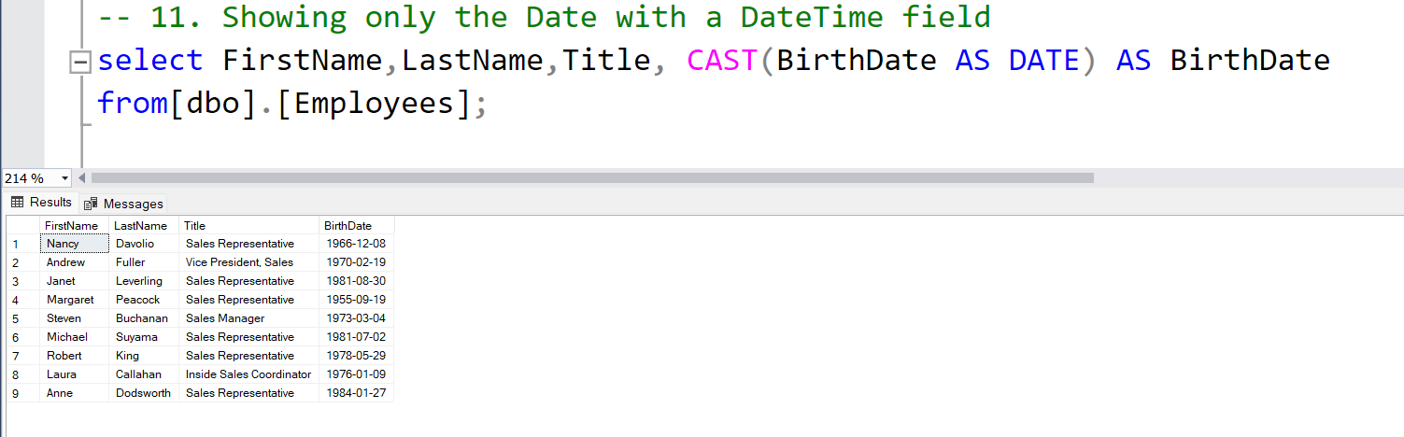
4. Showing only the Date with a DateTime field Show only the Date portions of the BirthDate field, without the time of the BirthDate field.

Slide 7
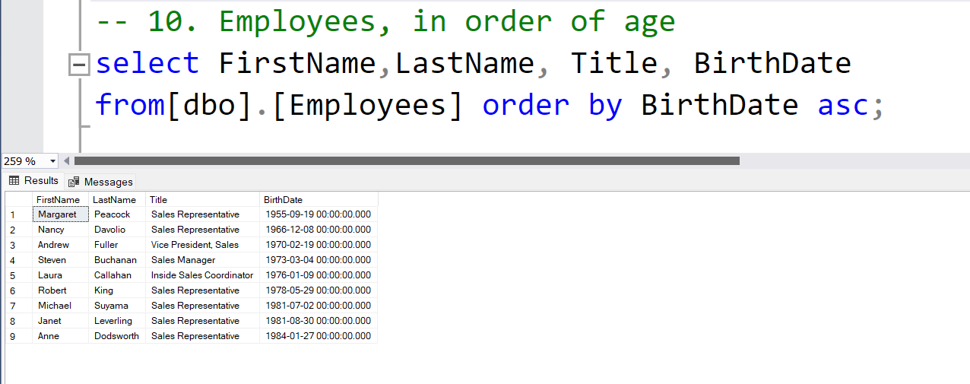
5. Employees, in order of age For all the employees in the Employees table, Order the results by BirthDate, so we have the oldest employees first.

Slide 8
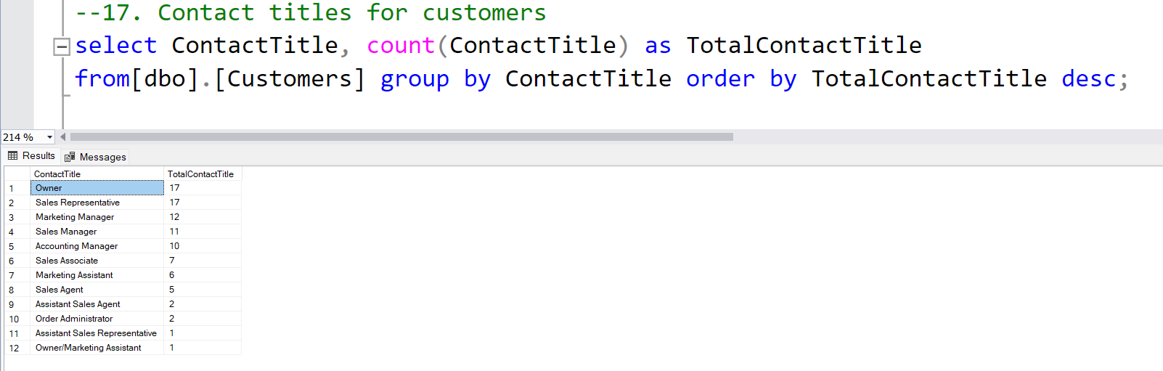
6. Contact titles for customers Show a list of all the different values in the Customers table for ContactTitles. Also include a count for each ContactTitle.

Slide 9
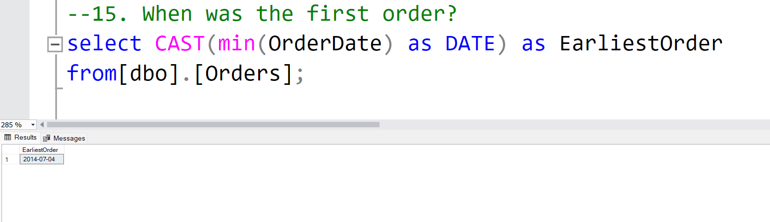
7. When was the first order? Show the date of the first order ever made in the Orders table.

Slide 10
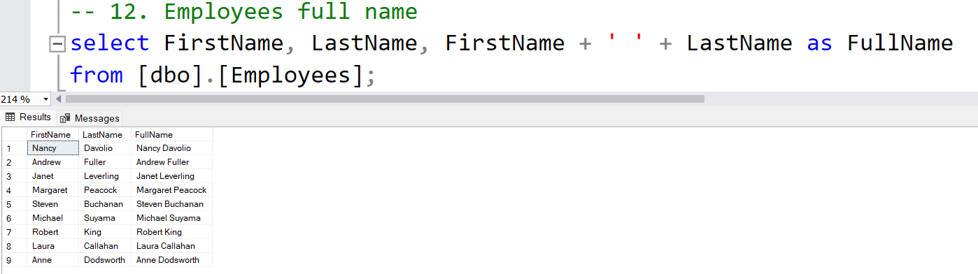
8. Employees full name Show the Name details and show FirstName and LastName joined together in one column, with a space in between.

Slide 11
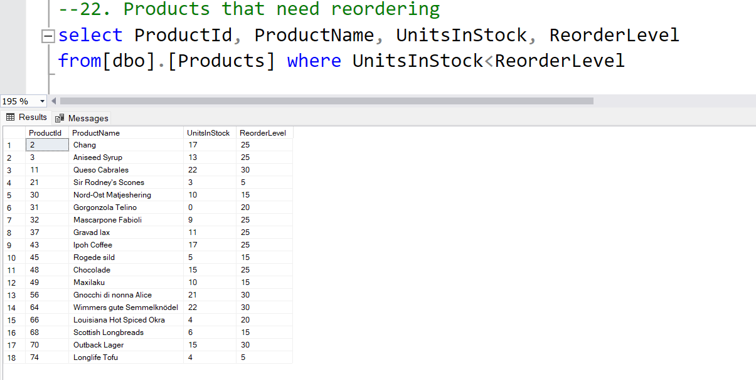
9. Products that need reordering. What products do we have in our inventory that should be reordered? Order the results by ProductID.

Slide 12
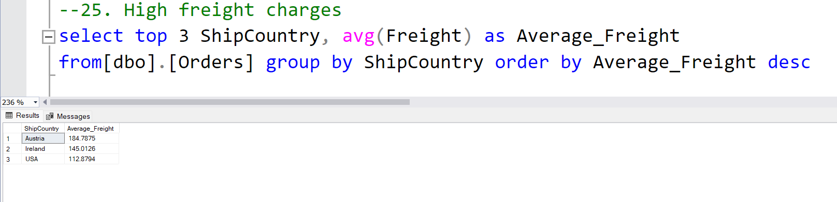
10. High freight charges Return the three ship countries with the highest average freight overall, in descending order by average freight.

Slide 13
Conclusion
From the above examples, we can see how SQL is utilized to query and manipulate data stored in a relational database and retrieve the necessary relevant data as per the user-defined constraints and conditions
Thank You.

